Slide 1
EFT and Index Performance Dashboard
Presentation
Group Members:
Justin
Cruzald
John
Wally
Ashley

Slide 2
Project Overview The undertaken project involved the development of a financial dashboard designed to display the historical indexes and prices of exchange-traded funds (ETFs) spanning the period from 2018 to 2021. The project initially entailed the creation of a database using PG Admin, followed by the establishment of a connection with the PostgreSQL database using a Flask API, and the definition of routes for various indexes and ETFs. Subsequently, visualizations were generated using JavaScript. The main goal of our project is to enable a comprehensive evaluation of various funds over time, providing users with an easy-to-use interface to observe these changes and make well-informed investment decisions.

Slide 3
Indexes VS ETFs
INDEXES
ETFs
Indexes (like the NASDAQ, S&P500, NYSE, DJIA), are a collection of stocks and other assets that represent a particular segment of the market. They provide a benchmark against which the performance of individual investments can be measured..
Exchange Traded Funds (ETFs) are funds that are traded on stock exchanges,
much like individual stocks. ETFs consist of a collection of securities, like stocks, bonds, commodities and more but with the flexibility of trading like a stock.
By design, they are built to track the performance of a specific asset class, sector, index, or commodity. ETFs allow investors to gain exposure to various assets and easily diversify their portfolio without having to buy individual securities

Slide 4
What to consider when choosing between Indexes and ETFs
With stocks, you invest in just one company at a time, while ETFs offer exposure to a basket of stocks
ETFs provide the opportunity to place stock orders
ETFs have lower expense rations but higher trading cost.
There are advantages and risks associated with tracking the trend to purchase an ETF
With individual stocks, you—or a professional investment adviser—have to select which stocks to buy and sell. ETFs are managed by professionals
Although it’s possible to create your own diversified portfolio of individual stocks, it can be costly. ETFs are generally cheaper

Slide 5
Project Interaction In order to interact with the project, individuals can utilize the dropdown menu next to each of the three distinct visual representations. These visualizations, which will be displayed in the following slides, depict the historical price trends of the exchange-traded funds (ETFs), indexes, and a comparison between a selected ETF and Index over a period of time. Through the use of the dropdown menu, users have the capability to select the specific index or ETF they wish to examine and concentrate on that particular chart. Additionally, users have the option to select multiple funds or indexes for the purpose of comparing two or more specific trends. This comparative analysis can be particularly valuable for observing whether multiple trends exhibit similar fluctuations as a result of different socioeconomic factors, such as the impact of events like the Covid-19 pandemic or market crashes.

Slide 6
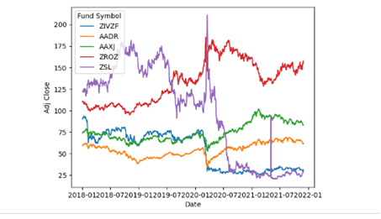
ETFs Dashboard

Slide 7
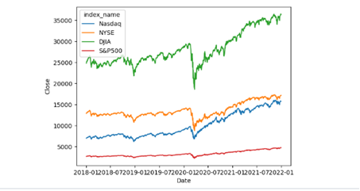
Indexes Dashboard

Slide 8
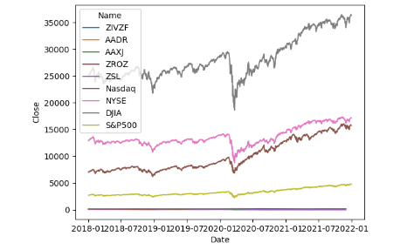
Merged Dashboard

Slide 9
Project objective: The primary objective of this dashboard is to illustrate the significant variance in performance between ETFs and indexes, emphasizing the necessity of comprehensive research and strategic planning when making investment decisions. We encourage you to utilize this dashboard to analyze various ETFs and indexes, enabling you to make well-informed investment choices. It is crucial to bear in mind that past performance does not guarantee future results. We wish you success in your investment endeavors!

Slide 10
Ethical Considerations: Our ethical considerations included referencing our sources and ensuring we were not sharing private information. We did this by cross-checking with Kaggle that it was allowed to be used as a source. Since we were using publicly accessible data from ETFs and indices, we were not worried that we would be committing any ethical and/or legal violations. However, we still double-checked our work, and by doing this, we concluded that our data was public information and safe to share.

Slide 11
Data Sources https://www.kaggle.com/datasets/stefanoleone992/mutual-funds-and-etfs https://www.marketwatch.com/investing/index/spx/download-data?mod=mw_quote_tab https://www.marketwatch.com/investing/index/nya/download-data?mod=mw_quote_tab https://www.marketwatch.com/investing/index/ndx/download-data?mod=mw_quote_tab https://towardsdatascience.com/how-to-make-multi-index-index-charts-with-plotly-4d3984cd7b09 https://github.com/nikitakhutorni/multi-index-chart/blob/main/MultiIndexChart/multi_index_chart.ipynb https://medium.com/@yushuhearn/mastering-multi-chart-visualization-captivating-line-charts-for-top-stocks-and-sector-rotation-1e628873e407

